Slide 1


Readr, readxl, and rvest (Web Scraping)
CSCI 444

Slide 2

Base R
Base R offers many functions for importing
  Imported as a data frame
  Uses . (dot)
  read.csv → , (comma) separated
  read.csv2 → ; (semicolon) delimited
  read.delim → specify delimiter
  read.table

Slide 3


Readr Package
Preferred over Base R
  Much faster → up to 10x
  Uses consistent naming scheme
    Arguments: col_names and col_types instead of header and colClasses
      names <- c("Q1", "Q2", "Q3", "Q4", "Q5", "Q6", "Q7", "Q8", "Q9","Q10")
      read_csv("data/myFile.csv", col_names = names, col_types = cols(.default="c") )
      read_csv("data/myFile2.csv", col_names = names, col_types = cols(.default="c“, Q1="d", Q10 = "i“))
      Allows for spaces in header names → encloses in ` ` (backticks)
Imports strings as strings
  Use stringr package to manipulate
Parses common date/time formats
Progress bar for large file imports
Slower for data tables → Use Base R’s data.table
  http://yetanothermathprogrammingconsultant.blogspot.com/2016/12/reading-csv-files-in-r-readcsv-vs.html

Slide 4
Helpful stringr Functions
x <- c("why", "video", "cross", "extra", "deal", "authority")
Regular expression (regex)
str_subset(x, "[aeiou]")
#> [1] "video" "cross" "extra" "deal" "authority"
str_replace(x, "[aeiou]", "?")
#> [1] "why" "v?deo" "cr?ss" "?xtra" "d?al" "?uthority"
str_remove(x, "e")
#> [1] "why" "vido" "cross" "xtra" "dial" "authority"
str_detect(x, "[aeiou]")
#> [1] FALSE TRUE TRUE TRUE TRUE TRUE
str_count(x, "[aeiou]")
#> [1] 0 3 1 2 2 4
str_length(x) #> [1] 3 5 5 5 4 9
str_extract(x, "[aeiou]")
#> [1] NA "i" "o" "e" "e" "a"

Slide 5

Readr CSV
Read csv, tsv, and txt as a tibble
read_csv(“filename.csv”) → raw csv file
read_csv(“filename.csv.zip”) → zipped csv file
read_csv(“URL of csv file location”) → remote csv file
read_csv(“filename.csv”, skip = 1)
  Skips first row → imported file’s header row ignored
  Can also specify col_names = TRUE to use imported file’s header row
write_csv(data, path = “data/filename.csv”, append = TRUE )
  default for append is FALSE

Slide 6
Example
inspections <- read_csv("data/inspections.csv", col_names = TRUE)
inspections <- inspections %>%
rename(inspectionID = `Inspection ID`,
DBA = `DBA Name`,
AKA = `AKA Name`,
license = `License #`,
facility = `Facility Type`,
inspectionDate = `Inspection Date`,
inspectionType = `Inspection Type`)
glimpse(inspections)

Slide 7

Readr TSV
Same as CSV → use TSV instead
read_tsv(“filename.tsv”) → raw tsv file
read_tsv(“filename.tsv.zip”) → zipped tsv file
read_tsv(“URL of tsv file location”) → remote tsv file
read_tsv(“filename.tsv”, skip = 1)
write_tsv(data, path = “data/filename.tsv”, append = TRUE )
  default for append is FALSE

Slide 8
Example
inpatient <- read_tsv("http://594442.youcanlearnit.net/inpatient.tsv", col_names = TRUE)
glimpse(inpatient)

Slide 9
Readr Generic Delimited
read_delim(“filename.txt”, delim = “separator”)
read_delim(“URL of file location”, delim = “separator”)
read_delim(“filename.txt”, delim = “^”, skip = 1)

Slide 10
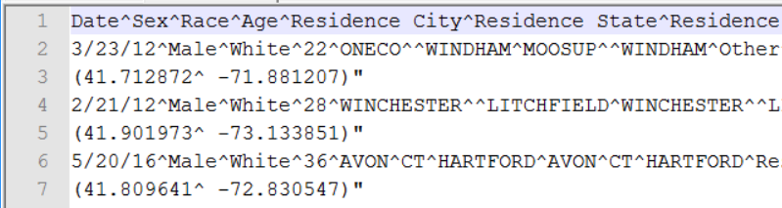
Example
death <- read_delim("data/drugdeaths.txt", delim = "^", col_names = TRUE)
glimpse(death)

Slide 11
readxl
Use readxl package for reading Excel files
read_excel(“filename.xlsx”,
sheet = “name”, Default is first sheet
range = “B1:C7”, Range of cells.
Could also be range = cell_cols(“B:C”)
col_names = c(“n1”, “n2” )) Names of columns
or TRUE to use first row
breakfast <- read_excel("F:/R/_Lectures/data/Breakfast.xls",
skip = 5,
col_names = c("Year", "Free", "Reduced", "Paid", "Total", "NumMeals", "PercentFree"))
View(breakfast)

Slide 12
Xlsx
Use xlsx package for writing Excel files
write.xlsx(as.data.frame(data),
“data/filename.xlsx”,
sheetName = “Data”,
col.names = TRUE,
row.names = FALSE)
write.xlsx(breakfast, “Free Breakfast.xlsx”,
sheetName = “Breakfast”,
col.names = TRUE,
row.names = TRUE)
File has column headers
Rows should not have row numbers added

Slide 13
Wide v. Long Datasets
Tidyverse assumes LONG
pivot_longer function → makes wide data set long
pivot_longer(data, cols, names_to, values_to)
  Cols are columns to include in <key, value> pairs – use colon ( : ) for multiple columns
    May use minus ( - ) to exclude cols
    Each column’s OU becomes new OBSERVATIONAL UNIT
  names_to is/are the new column name(s)
    Column header is now an OBSERVATIONAL UNIT
    Used for each value
values_to is/are the new column value(s)
  Observational Unit is still an OBSERVATIONAL UNIT
pew.long <- pew %>%
pivot_longer(cols = -religion, names_to = “income”,
values_to = “frequency”)
  from pew.csv
  pivot everything but the religion name
  think of transposing
religion | <$10k | $10-20k | $20-30k | $30-40k | $40-50k | $50-75k | $75-100k | $100-150k | >$150k
Agnostic | 27 | 34 | 60 | 81 | 76 | 137 | 122 | 109 | 84
Atheist | 12 | 27 | 37 | 52 | 35 | 70 | 73 | 59 | 74
Buddhist | 27 | 21 | 30 | 34 | 33 | 58 | 62 | 39 | 53
Catholic | 418 | 617 | 732 | 670 | 638 | 1116 | 949 | 792 | 633
Don't know/refused | 15 | 14 | 15 | 11 | 10 | 35 | 21 | 17 | 18
Evangelical Prot | 575 | 869 | 1064 | 982 | 881 | 1486 | 949 | 723 | 414

Slide 14
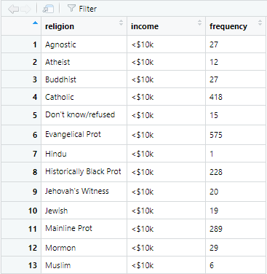
Wide To Long
pew <- read_csv("data/pew.csv", col_names = TRUE)
pew.long <- pew %>%
pivot_longer(cols = -religion,
names_to = “income”,
values_to = frequency”)

Slide 15
Long to Wide
pivot_wider function → makes long data set wide
pivot_wider(data, names_from = key,
values_from = value)
  Name of the <k, v> in the long data set to make into 1 line in wide data set
weather.wide <- pivot_wider(weather, names_from = element,
values_from = value)
  from mexicanweather.csv
  Uses element (key) becomes a VARIABLE
  Uses value (value) stays an OBSERVATIONAL UNIT
station | element | value | date
MX000017004 | TMAX | 310 | 4/1/1955
MX000017004 | TMIN | 150 | 4/1/1955
MX000017004 | TMAX | 310 | 5/1/1955
MX000017004 | TMIN | 200 | 5/1/1955
MX000017004 | TMAX | 300 | 6/1/1955
MX000017004 | TMIN | 160 | 6/1/1955
MX000017004 | TMAX | 270 | 7/1/1955
MX000017004 | TMIN | 150 | 7/1/1955
MX000017004 | TMAX | 230 | 8/1/1955
MX000017004 | TMIN | 140 | 8/1/1955
MX000017004 | TMAX | 230 | 9/1/1955
MX000017004 | TMIN | 150 | 9/1/1955

Slide 16
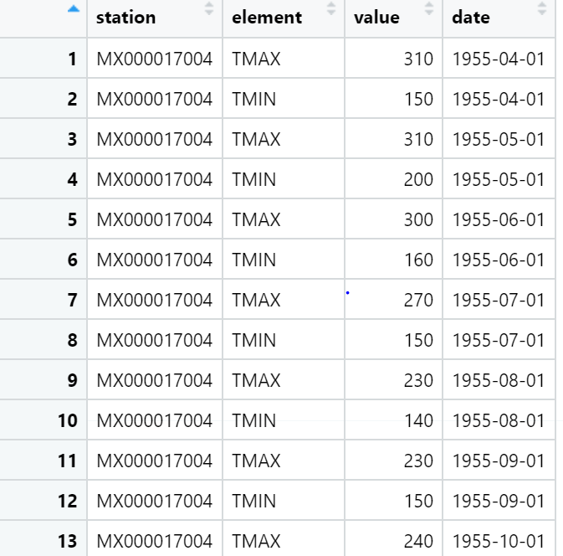
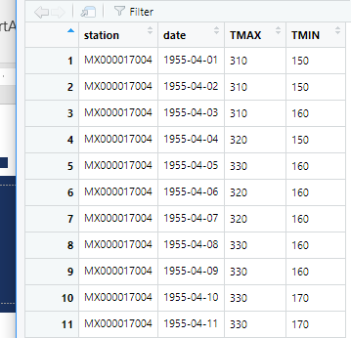
Long to Wide
weather <- read_csv("data/mexicanweather.csv", col_names = TRUE)
weather <- weather %>%
pivot_wider(names_from = element,
values_from = value)
View(weather)

Slide 17

Web Scraping
Web scraping is a technique for converting data in unstructured format (HTML tags) to structured formats, which can easily be accessed and used.
https://www.analyticsvidhya.com/blog/2017/03/beginners-guide-on-web-scraping-in-r-using-rvest-with-hands-on-knowledge/

Slide 18




Why Use Web Scraping
Movie ratings to create recommendation engines
Wikipedia for training deep learning models
Social media for sentiment analysis
Amazon for user reviews or feedback

Slide 19
Ways to Scrape Data
1. Human Copy-Paste → person analyzing and copying relevant information
2. Text pattern matching → regular expressions in programming languages
3. API Interface → websites such as Facebook, Twitter, LinkedIn provide prescribed formats that can be used for retrieving data
4. DOM (Document Object Model) Parsing → retrieve dynamic content from client-side scripts. Can also parse to retrieve specific parts of page

Slide 20

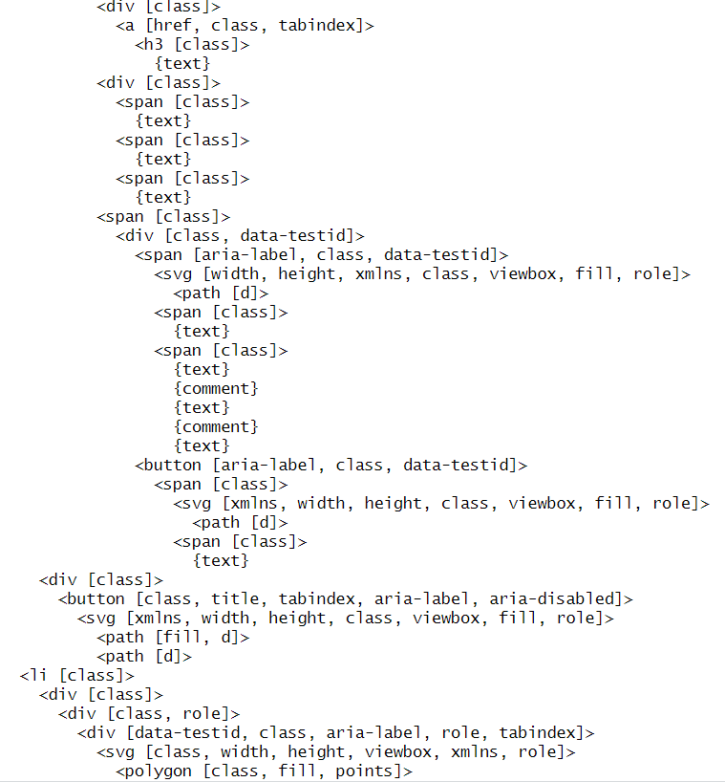
Document Object Model (DOM)
https://www.w3schools.com/js/js_htmldom.asp

Slide 21

Rvest & SelectorGadget
rvest part of tidyverse
  read_html → downloads html as xml
    xml_structure(page) list xml (xml2 package)
  html_node → grabs node content (xpath) USE SELECTORGADGET or CSS Peeper and Pesticide
  html_text → converts the node to text
  html_attr→ extracts value of an attribute
  Use str_remove(“string”) and str_replace(“\\n”, “”) and is.numeric and grep to wrangle, if necessary

Slide 22

Grep – Global Regular Expression
grep – finds a pattern in ALL vector elements
grep(pattern, vector)
  Pattern is a regular expression
  ^ designates to look at beginning
  $ designates to look at end
  ?! designates negative lookahead, or everything BUT this string
Examples
  gross <- gross[grep("\\$", gross)] - finds all occurences of $ in the vector gross
    gross[seq(1, length(gross), 2)] - returns every other value of gross beginning at index 1
    i.e., 1, 3, 5, 7…
  scores <- scores[grep("[^?!Rate]", scores)] - removes all occurrences of Rate in the vector scores

Slide 23

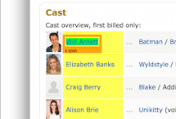


SelectorGadget
SelectorGadget → Chrome App that gives information about webpage
  Click SelectorGadget madgnifying glass by bookmarks
  Click element on webpage
    Element highlights green
    All similar elements highlighted yellow
  Click elements to deselect
    Element outlined red
    Highlighted yellow erased
https://chrome.google.com/webstore/detail/selectorgadget/mhjhnkcfbdhnjickkkdbjoemdmbfginb?hl=en

Slide 24

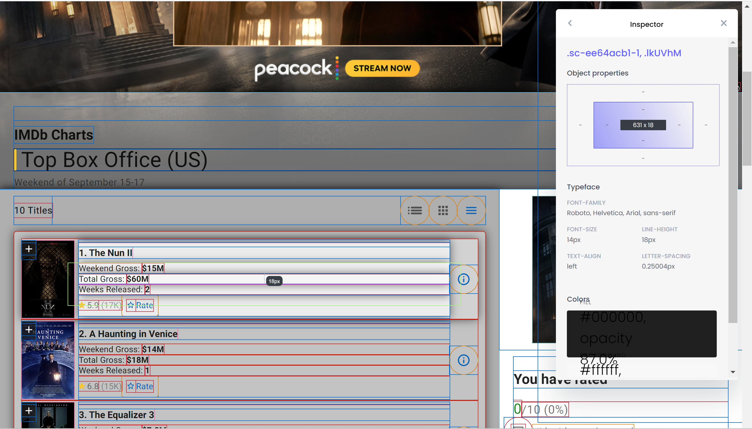

CSS Peeper & PEsticide
CSS Peeper gives the xpath
Pesticide gives the “boxes” on the webpage

Slide 25

Example - IMDB
Use robottxt package to verify web scraping allowed
  robot.txt used by websites if web scraping allowed
  paths_allowed(domain = "imdb.com")
  [1] TRUE

Slide 26
Example – IMDB Top Grossing Movies of All Time
scores <- page %>%
html_nodes(".ratingGroup--imdb-rating") %>%
html_text() %>%
str_sub(start=1, end=3) %>%
as.numeric()
imdb_top_250 <- tibble(
title = titles,
year = years,
score = scores
)
page <- read_html("http://www.imdb.com/chart/top")
titles <- page %>%
html_nodes(".ipc-title-link-wrapper") %>%
html_text()
years <- page %>%
html_nodes(".secondaryInfo") %>%
html_text() %>%
as.numeric() %>%
na.omit()
From CSS Peeper
You may also go to website and save to your local machine (ctrl-S or cmd-S).
Then, read_html from your local dir

Slide 27
Html_Text() v. HTML_ATTR()
Say I have the following html anchor tag:
  <a href="olemiss.edu">University of Mississippi</a>
html_nodes("a") %>%
  html_text() → Use when you want to extract the text between tags
    html_text() → extracts the text: University of Mississippi
  html_attr("attributeName") → Use when you want to extract the value of an attribute
    html_attr("href") → Extracts the URL: olemiss.edu

